Slide 1
OOM PROJECT – 4 Coefficient of Restitution Visualizer
Submitted by:
ABHAY PARIHAR (IIT2020074)
Shreyansh Netam (IIT2020177)
ANUSHTHA BAGERIA (IIT2020064)
ASHUTOSH SANJAY VERMA (IIT2020072)

Slide 2

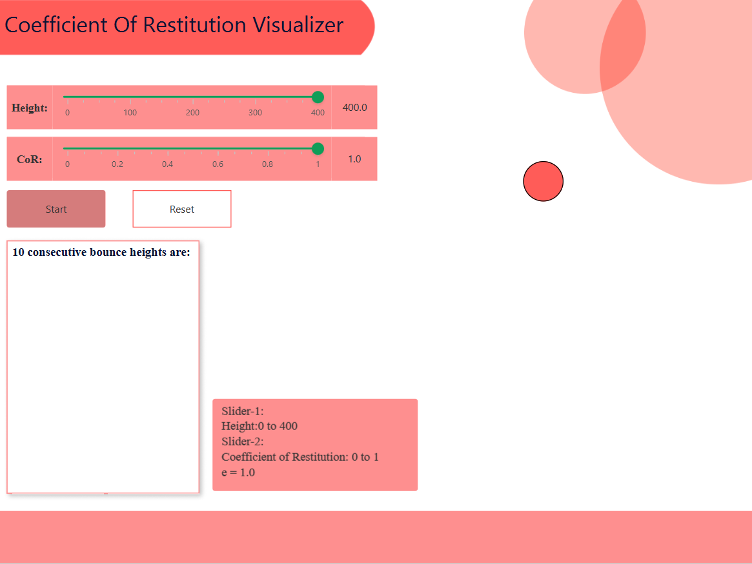
Problem Statement
This simulator is showing the height of several bounce after the ball is dropped from rest.
First we have to set height from which the ball will free fall by slider 1 and next have to set the value of e by slider 2.
Then two buttons are present start and reset.

Slide 3
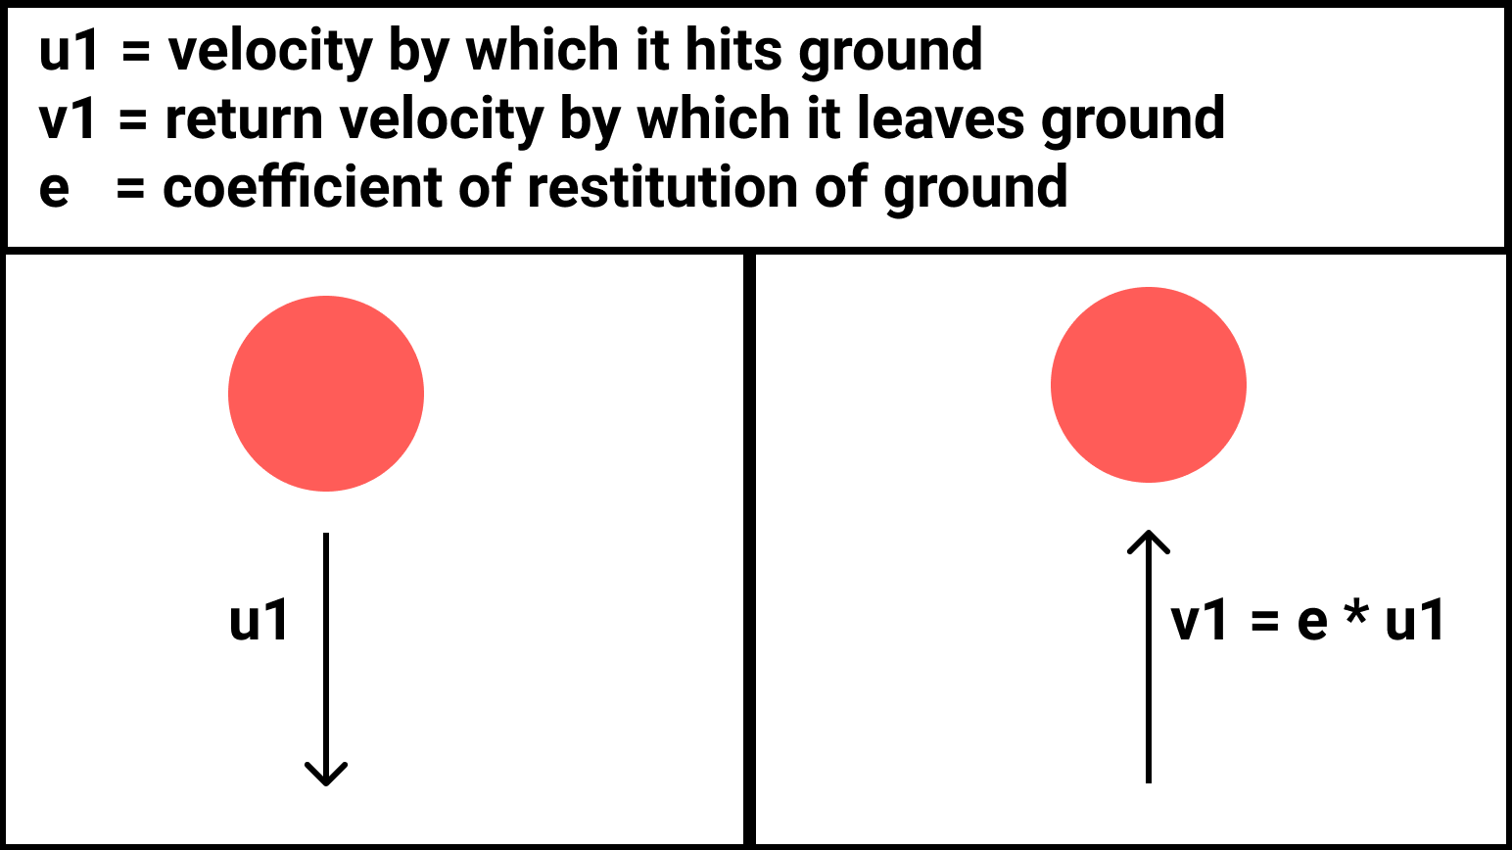
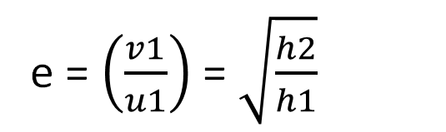
What is Coefficient of Restitution?
The coefficient of restitution is defined as the ratio of the final velocity to the initial velocity between two objects after their collision.
e = $\left(\frac{v1}{u1}\right)$ = $\sqrt{\frac{h2}{h1}}$
h1 = height from ball dropped
h2 = height up to ball bounces back

Slide 4
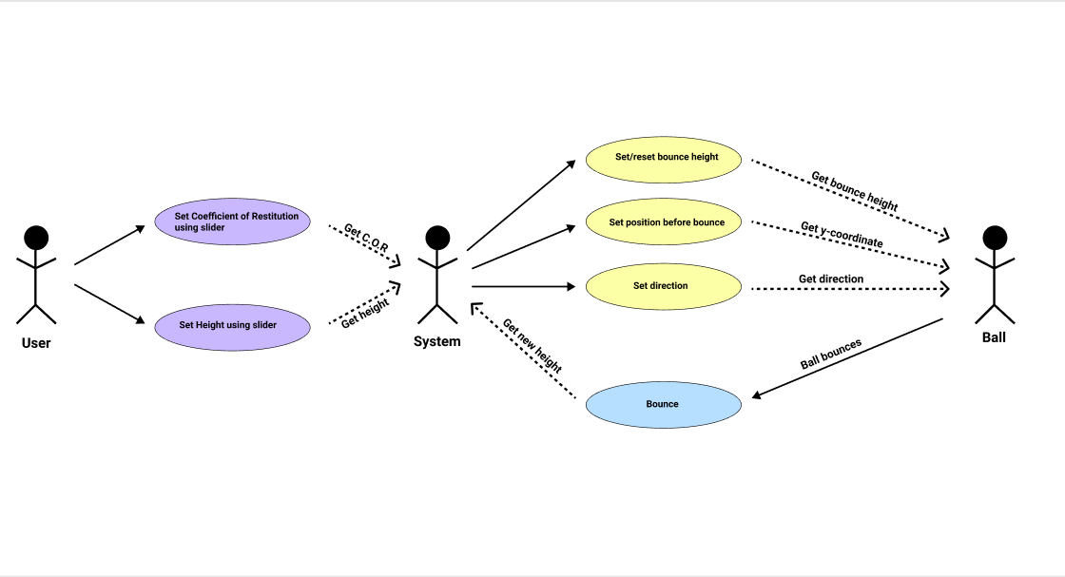
Use Case Diagram

Slide 5
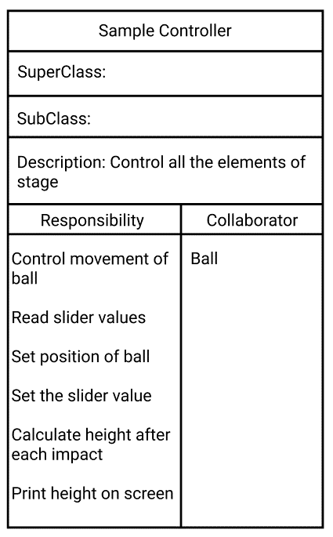
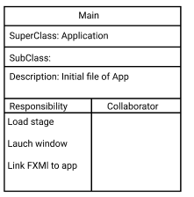
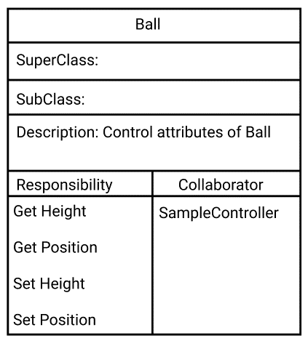



CRC

Slide 6
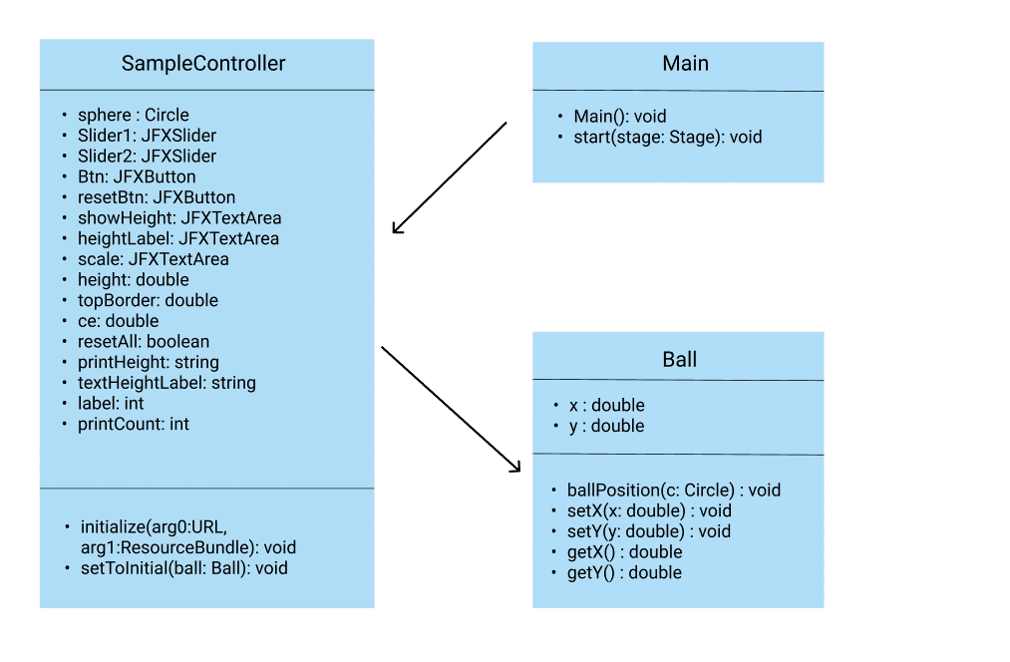

Class Diagram

Slide 7
Class Application
The entry point for JavaFX applications is the Application class. The JavaFX runtime does the following, in order, whenever an application is launched:
Constructs an instance of the specified Application class
Calls the init() method
Calls the start(javafx.stage.Stage) method
Waits for the application to finish, which happens when either of the following occur:
the application calls Platform.exit()
the last window has been closed and the implicitExit attribute on Platform is true
Calls the stop() method
Note that the start method is abstract and must be overridden. The init and stop methods have concrete implementations that do nothing.

Slide 8
Intitalizable Interface
Controller initialization interface.
This interface has been superseded by automatic injection of location and resources properties into the controller. FXMLLoader (Loads an object hierarchy from an XML document) will now automatically call any suitably annotated no-arg initialize() method defined by the controller. It is recommended that the injection approach be used whenever possible.

Slide 9
Timeline
Timeline in JavaFX is basically used to define free and flexible forms of animation. Timeline in JavaFX works on using the keyframes processing each of the keyframes individually and sequentially. It does not guarantee the timing of processing of each keyframe; instead it processes each keyframe at a specified time interval.
Timeline timeline = new Timeline();
KeyFrame kf = new KeyFrame(Duration.seconds(0));
timeline.getKeyFrames().addAll(kf, new KeyFrame(Duration.millis(20)));
timeline.setCycleCount(Timeline.INDEFINITE);
timeline.play();
timeline.stop();

Slide 10
TECH STACK
Java
Eclipse
FXML (Download FXML SDK)
JFoenix (Download JAR File)
SceneBuilder (Download Link)
GitHub (GitHub Repository)
Figma (Figma File Link)

Slide 11
WORKING

Slide 12


